Slide 1


CoB191: Business Analytics I
Chapter 6
Modified and adapted by Ehsan Teymourian
Notes:
Add slide notes here

Slide 2
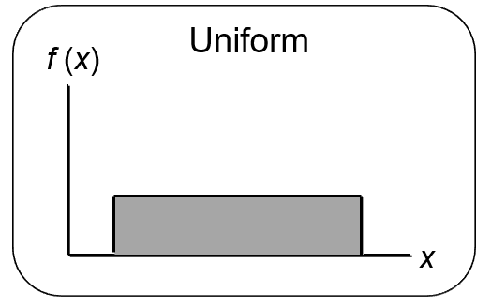
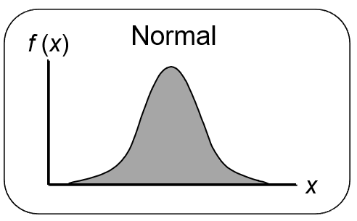
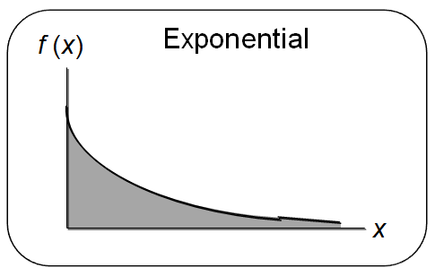
Chapter 6 Continuous Probability Distributions
Uniform Probability Distribution
Normal Probability Distribution
Exponential Probability Distribution

Slide 3
Continuous Probability Distributions (1 of 2)
A continuous random variable can assume any value in an interval on the real line or in a collection of intervals.
It is not possible to talk about the probability of the random variable assuming a particular value.
Instead, we talk about the probability of the random variable assuming a value within a given interval.

Slide 4
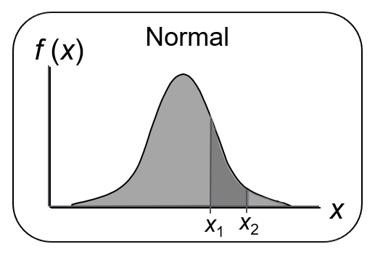
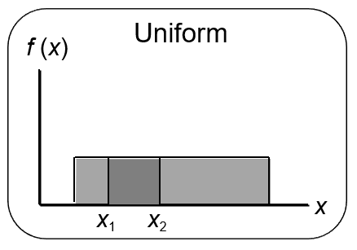
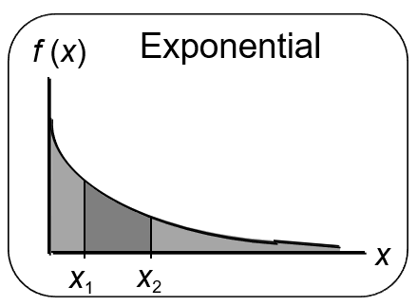
Continuous Probability Distributions (2 of 2)
The probability of the random variable assuming a value within some given interval from x₁ to x₂ is defined to be the area under the graph of the probability density function between x₁ and x₂.

Slide 5
Uniform Probability Distribution (1 of 4)
A random variable is uniformly distributed whenever the probability is proportional to the interval’s length.
The uniform probability density function is:
Expected Value of x
where: a = smallest value the variable can assume
b = largest value the variable can assume
Variance of x

Slide 6
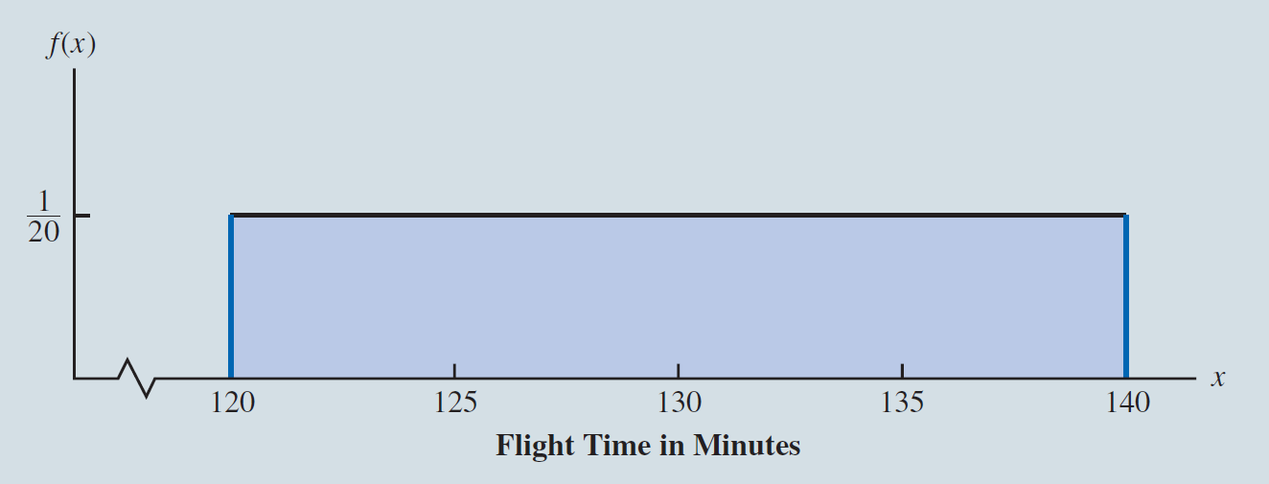
Uniform Probability Distribution (2 of 4)
Example: Flight time of an airplane traveling from Chicago to New York
Suppose the flight time can be any value in the interval from 120 minutes to 140 minutes.

Slide 7
Uniform Probability Distribution (3 of 4)
Uniform Probability Density Function
where:
x = Flight time of an airplane traveling from Chicago to New York
Expected Value of x

Slide 8
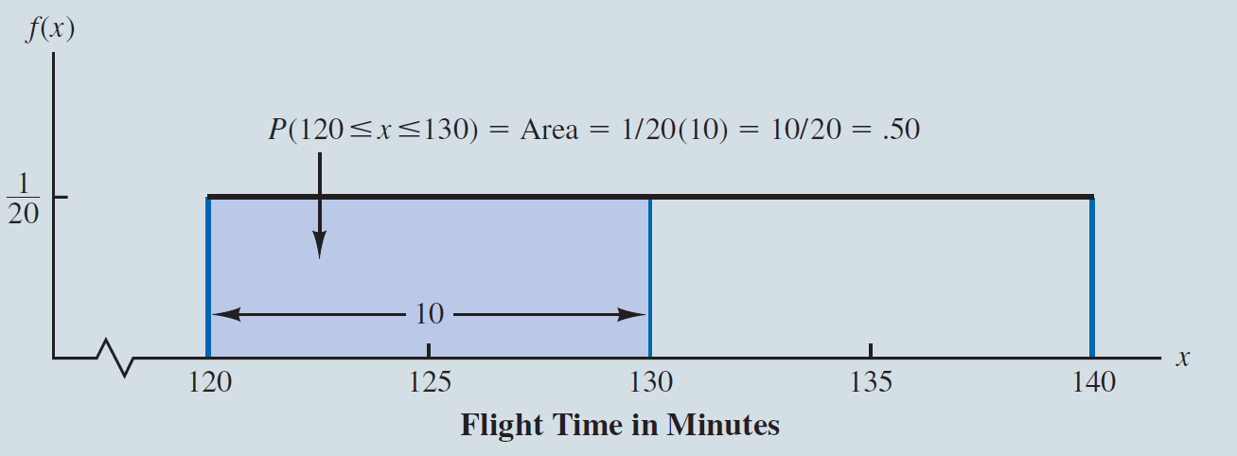
Uniform Probability Distribution (4 of 4)
Example: Flight time of an airplane traveling from Chicago to New York
The probability of a flight time between 120 and 130 minutes

Slide 9
Area as a Measure of Probability
The area under the graph of f(x) and probability are identical.
This is valid for all continuous random variables.
The probability that x takes on a value between some lower value x₁ and some higher value x₂ can be found by computing the area under the graph of f(x) over the interval from x₁ to x₂.

Slide 10
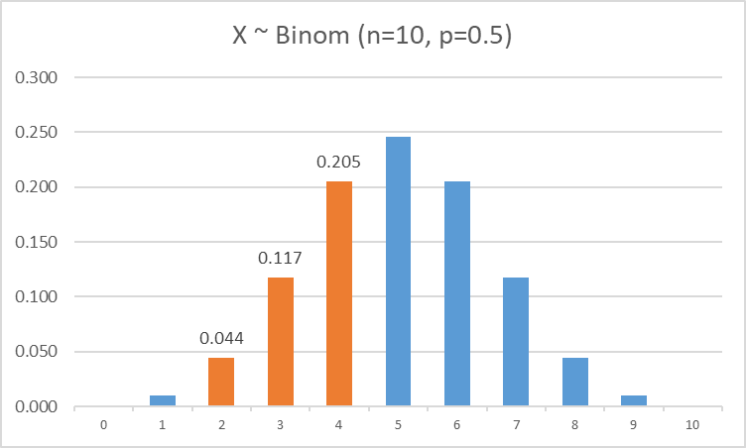
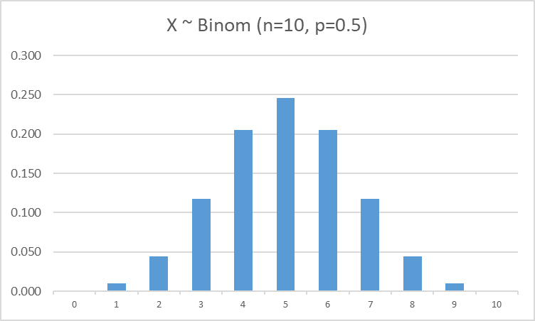
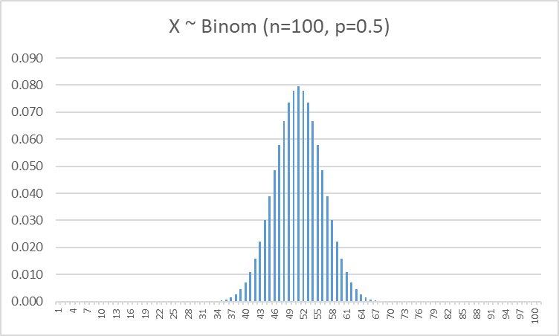
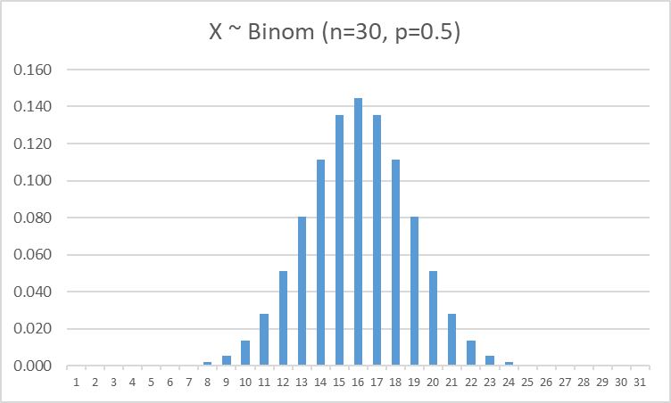

Discrete >>> Continuous

Slide 11
The area under the graph of f(x) and probability
f(x)
f(x)
b=?
f(x)
a=?
2
3
5
P(1<x<10)=1
1
2
4
1
10

Slide 12
Normal Probability Distribution (1 of 8)
The normal probability distribution is the most common distribution for describing a continuous random variable.
It has been used in a wide variety of applications including:
Heights of people
Test scores
Rainfall amounts
Scientific measurements
It is widely used in statistical inference.
Abraham de Moivre, a French mathematician, published The Doctrine of Chances in 1733. He derived the normal distribution.

Slide 13
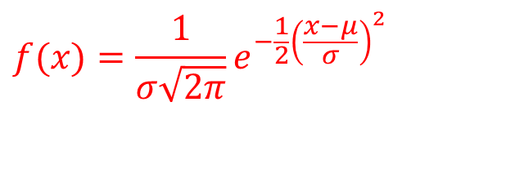
Normal Probability Distribution (2 of 8)
Normal Probability Density Function
$$f(x)=\frac{1}{σ\sqrt{2π}}e^{−\frac{1}{2}{\left(\frac{x−μ}{σ}\right)}^{2}}$$
Where µ = mean
σ = standard deviation
π = 3.14159
e = 2.71828

Slide 14
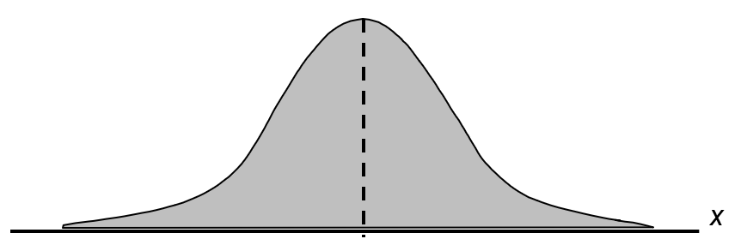
Normal Probability Distribution (3 of 8)
Characteristics
The distribution is symmetric; its skewness measure is zero.
The highest point on the normal curve is at the mean, which is also the median and mode.

Slide 15
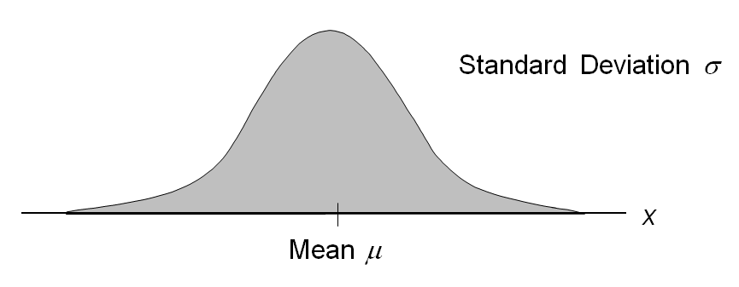
Normal Probability Distribution (4 of 8)
Characteristics
The entire family of normal probability distributions is defined by its mean µ and its standard deviation σ.

Slide 16
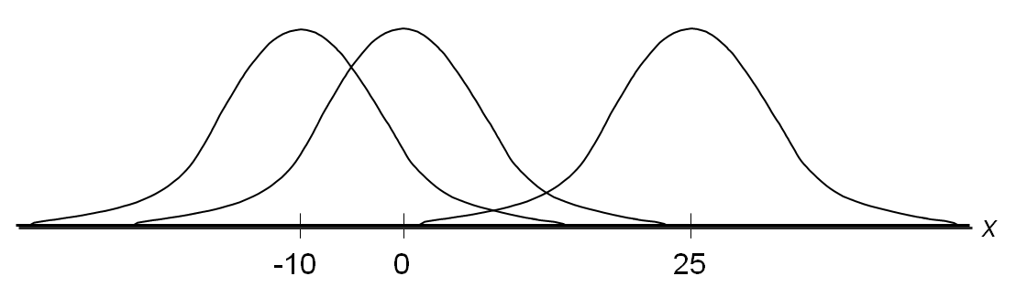
Normal Probability Distribution (5 of 8)
Characteristics
The mean can be any real value: negative, zero, or positive.

Slide 17
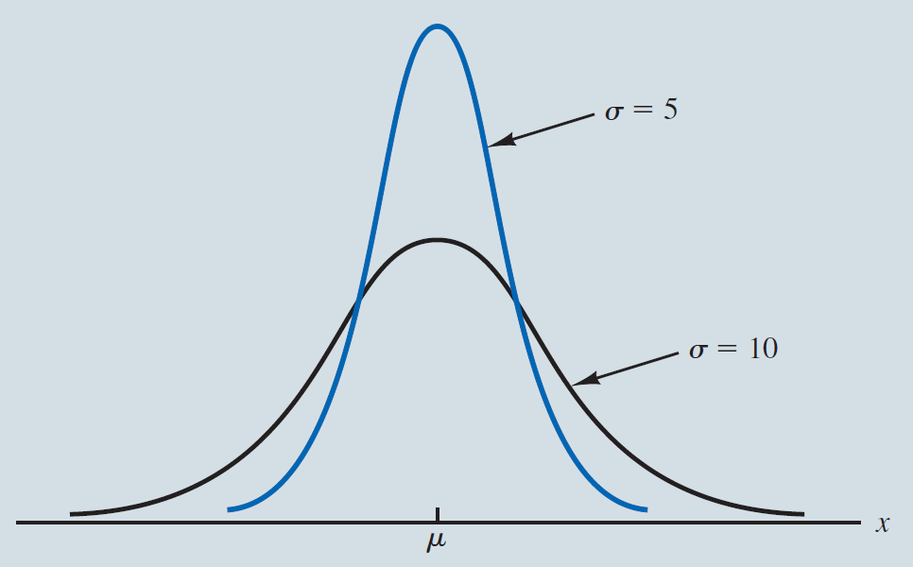
Normal Probability Distribution (6 of 8)
Characteristics
The standard deviation determines the width of the curve:
larger values result in wider, flatter curves.

Slide 18
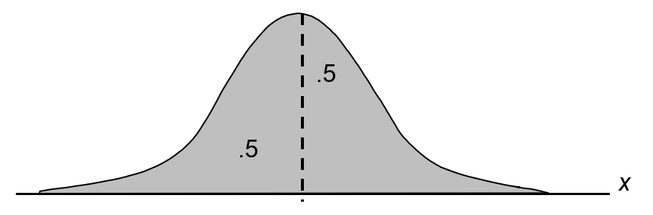
Normal Probability Distribution (7 of 8)
Characteristics
Probabilities for the normal random variable are given by areas under the curve. The total area under the curve is 1 (.5 to the left of the mean and .5 to the right).

Slide 19
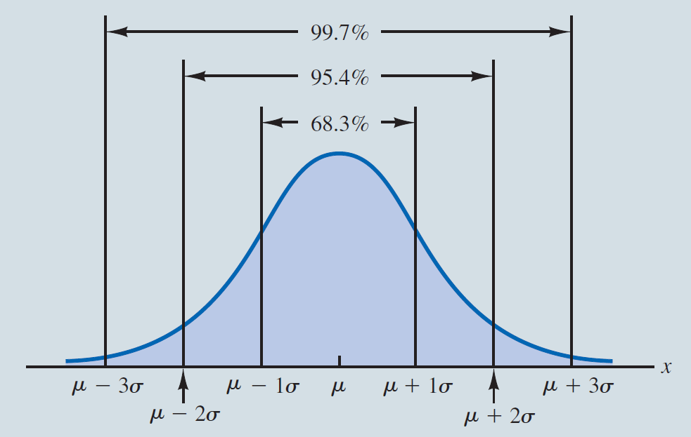
Normal Probability Distribution (8 of 8)
Characteristics (basis for the Empirical Rule)
About 68% of values of a normal random variable are within +/− 1 standard deviation of its mean.
About 95% of values of a normal random variable are within +/− 2 standard deviations of its mean.
About 99.7% of values of a normal random variable are within +/− 3 standard deviations of its mean.

Slide 20
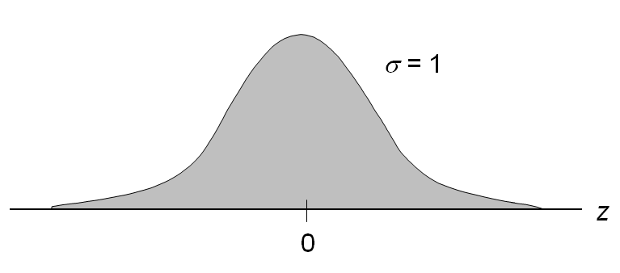
Standard Normal Probability Distribution (1 of 12)
Characteristics
A random variable having a normal distribution with a mean of 0 and a standard deviation of 1 is said to have a standard normal probability distribution.
The letter z is used to designate the standard normal random variable.

Slide 21
Standard Normal Probability Distribution (2 of 12)
Converting to Standard Normal Distribution
We can think of z as a measure of the number of standard deviations x is from µ.

Slide 22
Using Excel to Compute Standard Normal Probabilities (1 of 3)
Excel has two functions for computing probabilities and z values for a standard normal probability distribution.
NORM.S.DIST function computes the cumulative probability given a z value.
NORM.S.INV function computes the z value given a cumulative probability.
“S” in the function names reminds us that these functions relate to the standard normal probability distribution.

Slide 23
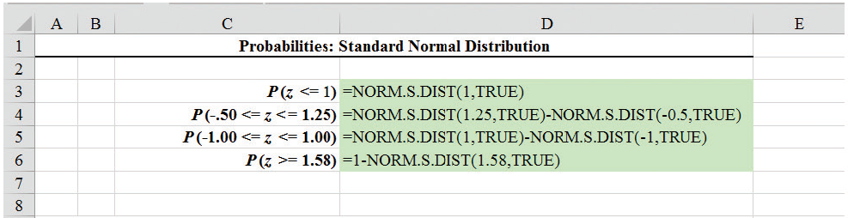
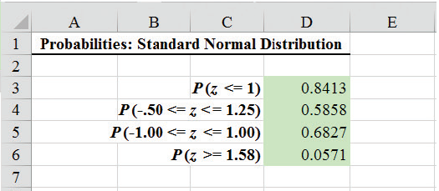
Using Excel to Compute Standard Normal Probabilities (2 of 3)
Excel Formula Worksheet

Slide 24
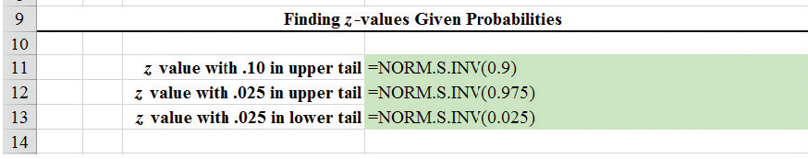
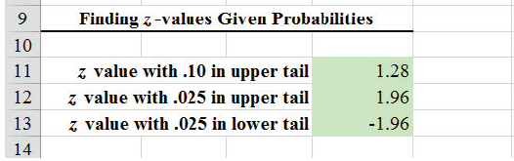
Using Excel to Compute Standard Normal Probabilities (3 of 3)
Excel Formula Worksheet

Slide 25
Standard Normal Probability Distribution (3 of 12)
Example: Grear Tire Company Problem
Grear Tire company has developed a new steel-belted radial tire to be sold through a chain of discount stores. But before finalizing the tire mileage guarantee policy, Grear’s managers want probability information about the number of miles of tires will last.
It was estimated that the mean tire mileage is 36,500 miles with a standard deviation of 5000. The manager now wants to know the probability that the tire mileage x will exceed 40,000.

Slide 26
Standard Normal Probability Distribution (4 of 12)
Example: Grear Tire Company Problem
Solving for the Probability
Step 1: Convert x to standard normal distribution.
Step 2: Find the area under the standard normal curve to the left of z = .7.

Slide 27
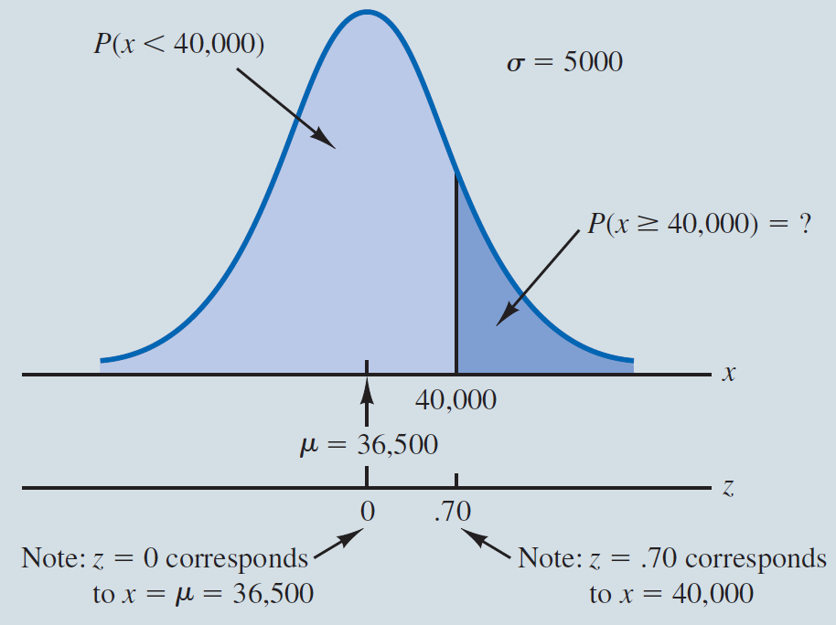
Standard Normal Probability Distribution (5 of 12)
Example: Grear Tire Company Problem

Slide 28
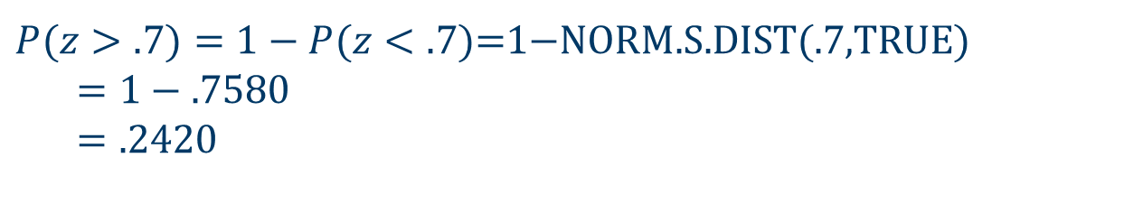
Standard Normal Probability Distribution (6 of 12)
Example: Grear Tire Company Problem
Solving for the Probability
Step 3: Compute the area under the standard normal curve to the right of z = .7
$P(z>.7)=1−P(z<.7)$=1$−$NORM.S.DIST(.7,TRUE) $$=1−.7580 \\ =.2420$$

Slide 29
Standard Normal Probability Distribution (7 of 12)
Example: Grear Tire Company Problem
Cumulative Probability Table for the Standard Normal Distribution (i.e., z table)
z | .00 | .01 | .02 | .03 | .04 | .05 | .06 | .07 | .08 | .09
. | . | . | . | . | . | . | . | . | . | .
.5 | .6915 | .6950 | .6985 | .7019 | .7054 | .7088 | .7123 | .7157 | .7190 | .7224
.6 | .7257 | .7291 | .7324 | .7357 | .7389 | .7422 | .7454 | .7486 | .7517 | .7549
.7 | .7580 | .7611 | .7642 | .7673 | .7704 | .7734 | .7764 | .7794 | .7823 | .7852
.8 | .7881 | .7910 | .7939 | .7967 | .7995 | .8023 | .8051 | .8078 | .8106 | .8133
.9 | .8159 | .8186 | .8212 | .8238 | .8264 | .8289 | .8315 | .8340 | .8365 | .8389
. | . | . | . | . | . | . | . | . | . | .

Slide 30
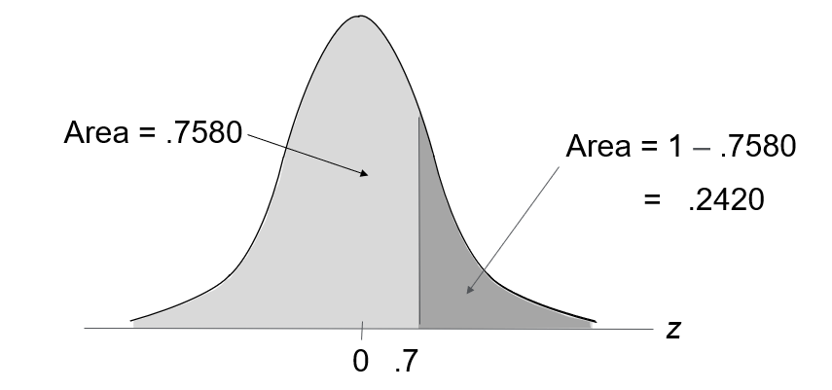
Standard Normal Probability Distribution (8 of 12)
Example: Grear Tire Company Problem

Slide 31
Standard Normal Probability Distribution (9 of 12)
Example: Grear Tire Company Problem
What should be the guaranteed mileage if Grear wants no more than 10% of tires to be eligible for the discount guarantee?
(Hint: Given a probability, we can use the standard normal table in an inverse fashion to find the corresponding z value.)

Slide 32
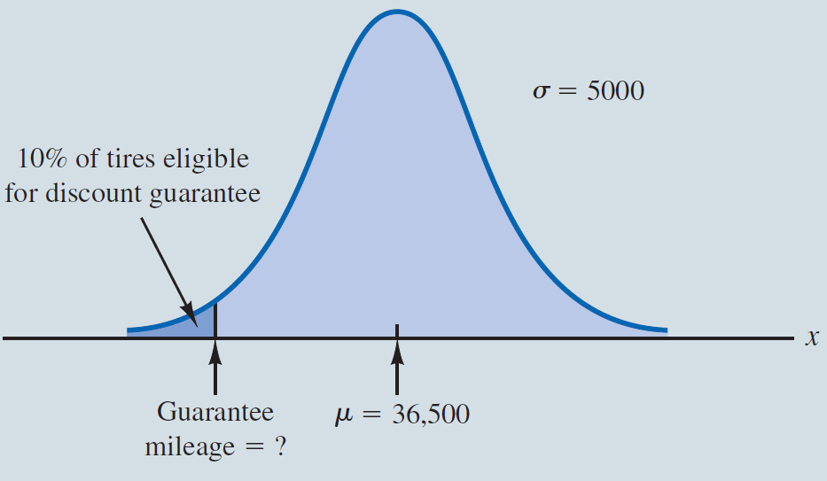
Standard Normal Probability Distribution (10 of 12)
Example: Grear Tire Company Problem
Solving for the guaranteed mileage

Slide 33
Standard Normal Probability Distribution (11 of 12)
Example: Grear Tire Company Problem—Solving for the guaranteed mileage
Step 1: Find the z value that cuts off an area of .1 in the left tail of the standard normal distribution.
z | .00 | .01 | .02 | .03 | .04 | .05 | .06 | .07 | .08 | .09
. | . | . | . | . | . | . | . | . | . | .
−1.5 | 0.0668 | 0.0655 | 0.0643 | 0.0630 | 0.0618 | 0.0606 | 0.0594 | 0.0582 | 0.0571 | 0.0559
−1.4 | 0.0808 | 0.0793 | 0.0778 | 0.0764 | 0.0749 | 0.0735 | 0.0721 | 0.0708 | 0.0694 | 0.0681
−1.3 | 0.0968 | 0.0951 | 0.0934 | 0.0918 | 0.0901 | 0.0885 | 0.0869 | 0.0853 | 0.0838 | 0.0823
−1.2 | 0.1151 | 0.1131 | 0.1112 | 0.1093 | 0.1075 | 0.1056 | 0.1038 | 0.1020 | 0.1003 | 0.0985
−1.1 | 0.1357 | 0.1335 | 0.1314 | 0.1292 | 0.1271 | 0.1251 | 0.1230 | 0.1210 | 0.1190 | 0.1170
. | . | . | . | . | . | . | . | . | . | .

Slide 34
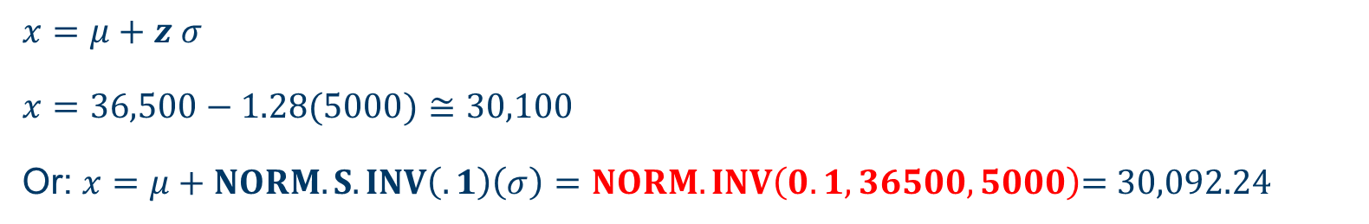
Standard Normal Probability Distribution (12 of 12)
From the table we see that z = −1.28 cuts off an area of 0.1 in the lower tail.
Step 2: Convert z_{.1} to the corresponding value of x.
$$x=μ+z_{ }σ$$
$x=36,500−1.28(5000)≅30,100$
Or: $x=μ+NORM.S.INV\left(.1\right)\left(σ\right)=NORM. INV\left(0.1, 36500, 5000\right)\text{=} 30,092.24$
Thus a guarantee of 30,100 miles will meet the requirement that approximately 10% of the tires will be eligible for the guarantee.

Slide 35
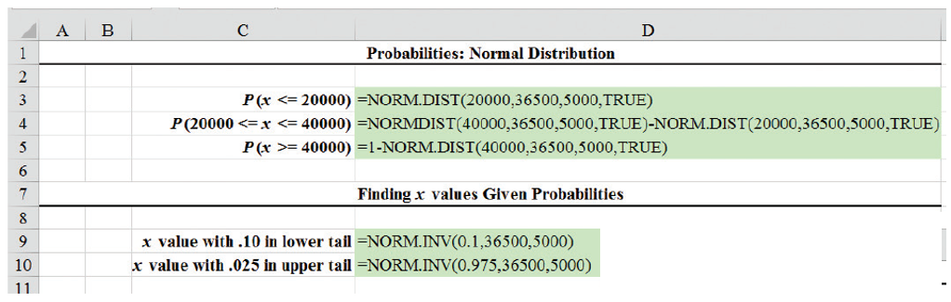
Using Excel to Compute Normal Probabilities
Excel has two other functions for computing cumulative probabilities and x values for any normal distribution with mean µ and standard deviation σ:
NORM.DIST is used to compute the cumulative probability given an x value.
NORM.INV is used to compute the x value given a cumulative probability.

Slide 36
Exponential Probability Distribution (1 of 7)
The exponential probability distribution is useful in describing the time it takes to complete a task.
The exponential random variables can be used to describe:
Time between vehicle arrivals at a toll booth
Time required to complete a questionnaire
Distance between major defects in a highway
In waiting line applications, the exponential distribution is often used for service times.

Slide 37
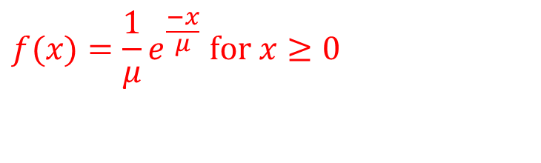
Exponential Probability Distribution (2 of 7)
A property of the exponential distribution is that the mean and standard deviation are equal.
The exponential distribution is skewed to the right. Its skewness measure is 2.
Density Function
$$f(x)=\frac{1}{μ}e^{\frac{−x}{μ}} \text{for} x≥0$$
where: µ = expected value or mean
e = 2.71828

Slide 38
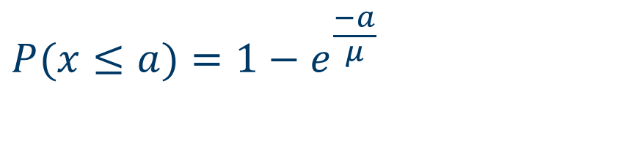
Exponential Probability Distribution (3 of 7)
Cumulative Probabilities
$$P(x≤a)=1−e^{\frac{−a}{μ}}$$
where:
a = some specific value of x

Slide 39
Exponential Probability Distribution (4 of 7)
Example: Loading time for trucks
Suppose x represents the loading time for a truck at the Schips loading dock and follows exponential distribution. If the mean or average loading time is 15 minutes, what is the probability that loading a truck will take 6 minutes or less?

Slide 40
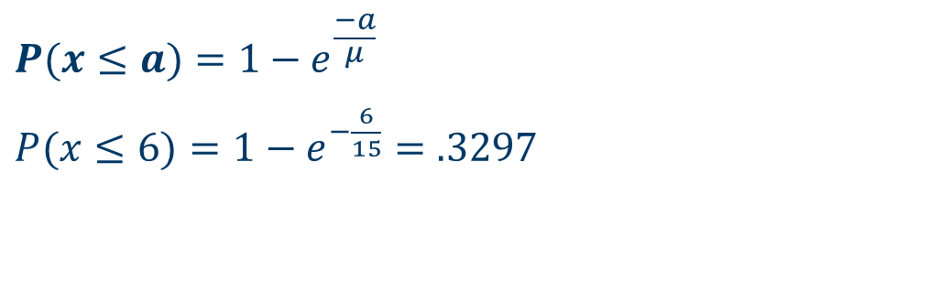
Exponential Probability Distribution (5 of 7)
Example: Loading time for trucks
$$P(x≤a)=1−e^{\frac{−a}{μ}}$$ $P(x≤6)=1−e^{−\frac{6}{15}}=.3297$
EXPON.DIST(a, 1/µ , TRUE) = EXPON.DIST(6, 1/15 , TRUE) = 0.32968

Slide 41
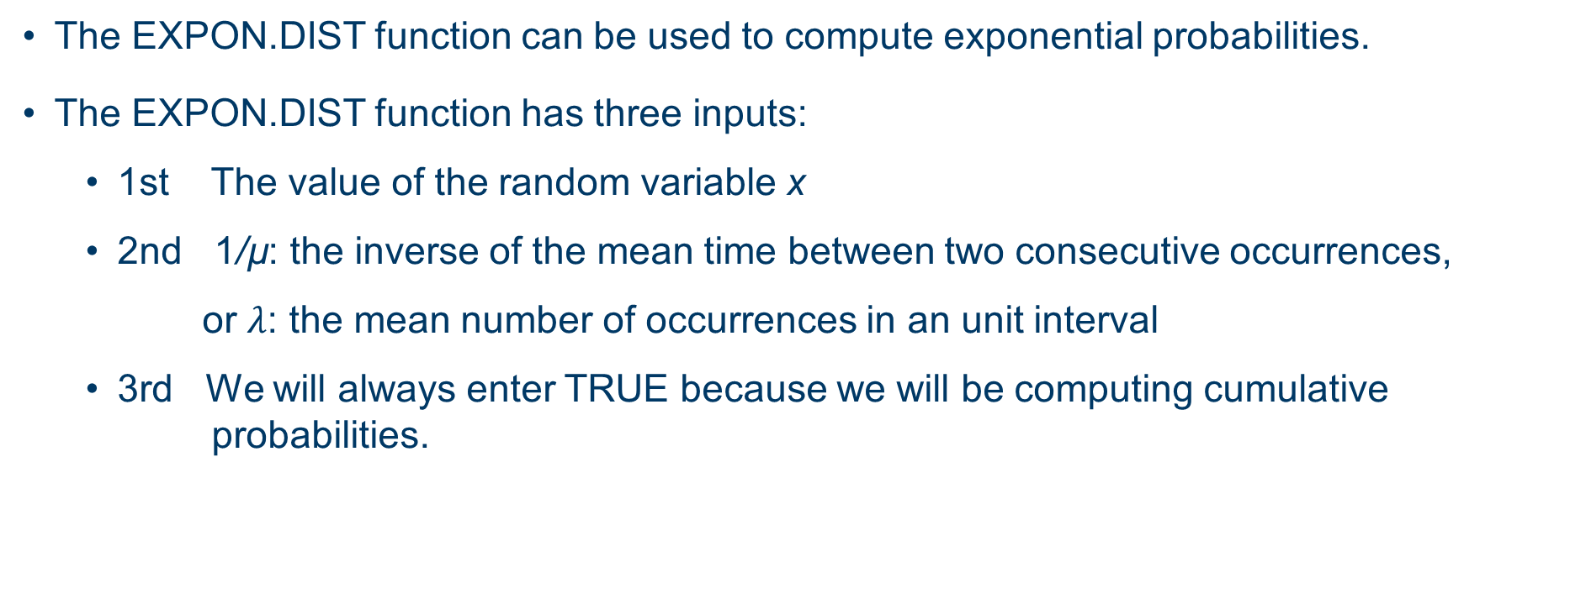
Using Excel to Compute Exponential Probabilities
The EXPON.DIST function can be used to compute exponential probabilities.
The EXPON.DIST function has three inputs:
1st The value of the random variable x
2nd 1/µ: the inverse of the mean time between two consecutive occurrences,
or $λ$: the mean number of occurrences in an unit interval
3rd We will always enter TRUE because we will be computing cumulative probabilities.

Slide 42
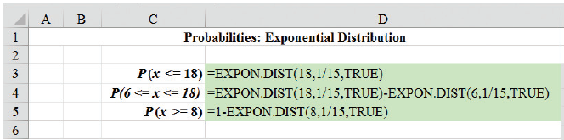
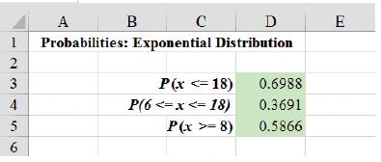
Exponential Probability Distribution (6 of 7)
Excel Formula Worksheet

Slide 43
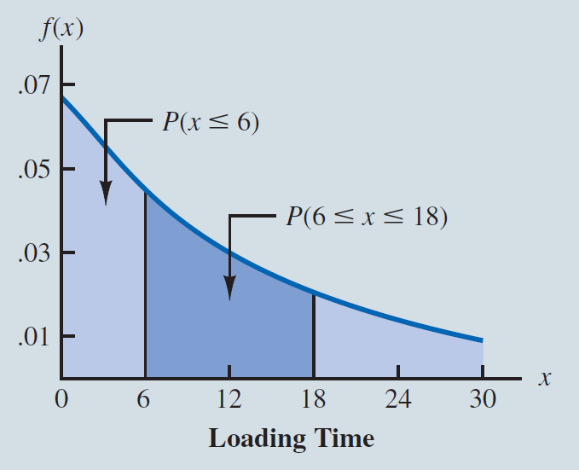
Exponential Probability Distribution (7 of 7)

Slide 44
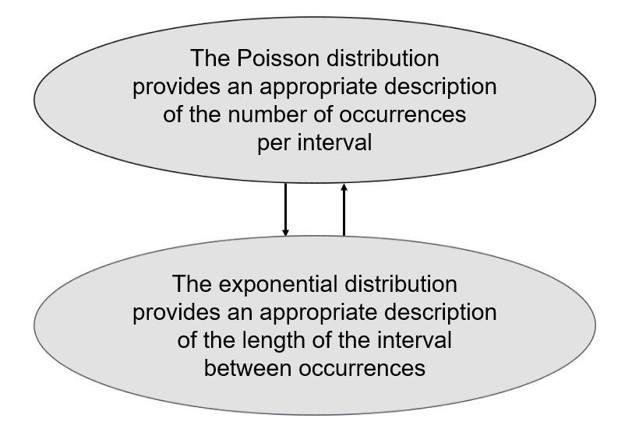
Relationship between the Poisson and Exponential Distributions

Slide 45
End of Chapter 6

